Slide 1
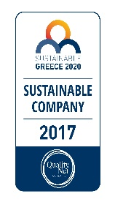
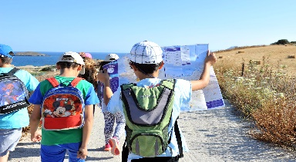
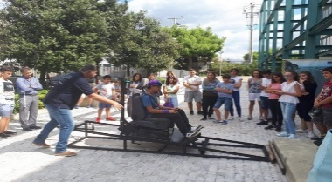
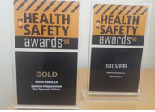
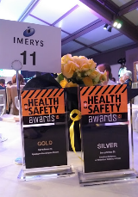
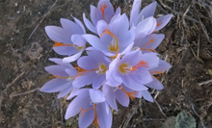
Awards in Greece: 2017 - 2019
Evaluation as 1 of the 21 “Most Sustainable Companies in Greece” for 2017, according to Sustainability Performance Directory
Bravo Sustainability Awards 2017. 1. Bravo Society: “MILOTERRANEAN Geo Experience”, 2. Bravo Market: “Creation of a new economic, environmentally friendly activity at the site of a restored perlite mine in Milos island”
Imerys SD Challenge 2017. Minerals Days Activities - “Take Safety Home!” and “All the time I play, minding anyway!”
Health & Safety Awards 2018. 1. Gold Award for “Take5 for your safety” initiative in category “Evaluation & Parameterization of New Occupational Risks”. 2. Silver Award for “Take Safety Home” program in category “Road Safety”, organized in collaboration with Road Safety Institute (R.S.I.) “Panos Mylonas”
Bravo Sustainability Award 2018. Bravo Market: “FLU-ACE condensing flue gas economizer in Tsigrado plant”
Imerys SD Challenge 2018. 1. "Propagation of rare, endemic and endangered plant species". 2. "Milos Mining Museum 20th anniversary: an educational and cultural center on Milos island"
Health & Safety Awards 2019 1. Gold Award for “Health & Wellbeing initiatives for the employees 2. Silver Award "Preparedness Response in Emergency Situations”
Bravo Sustainability Award 2019 Bravo Environment: “Endemic, rare and endangered plant species of Milos-Saving the lost treasure of the island”

